Slide 1

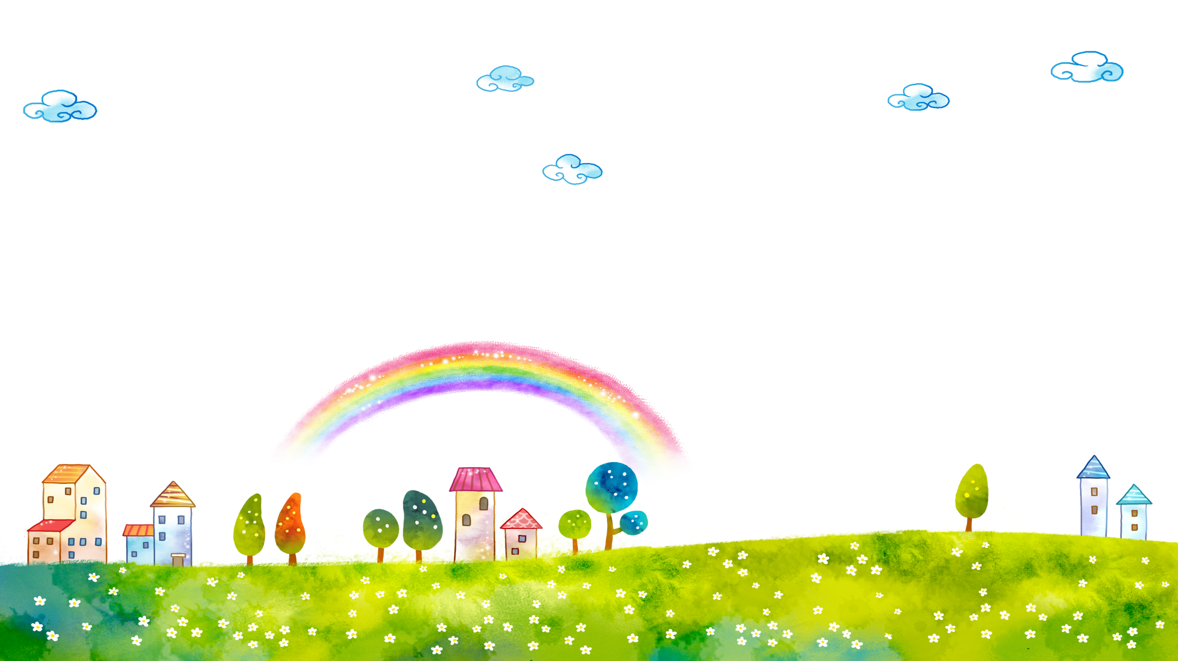
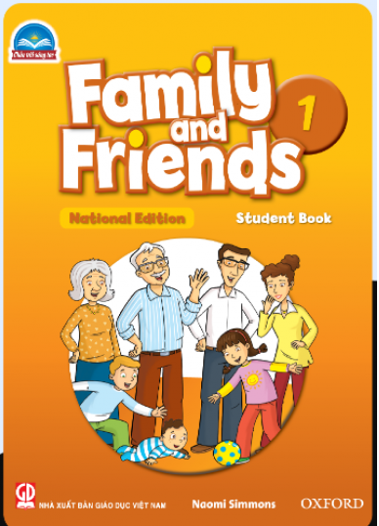

FAMILY &FRIENDS 1
National Edition

Slide 2
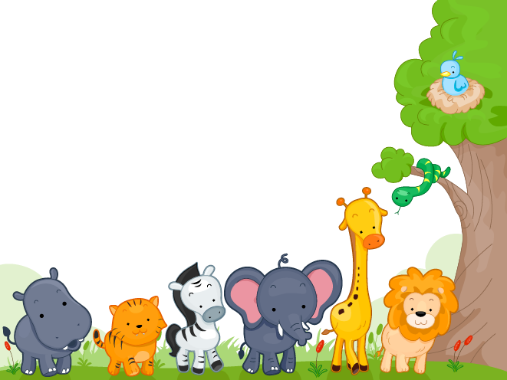

UNIT 4 : THEY’RE BEARS !
LESSON 4 : NUMBERS

Slide 3


Slide 4

Notes:
Students work in groups of 5
Each group has a mini board
Say a number
Students listen and write the number on the board
The quickest group says: STOP THE BUS and raises their board.
The whole group says the number aloud.
Continue with all the numbers in random order

Slide 5
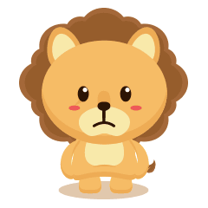
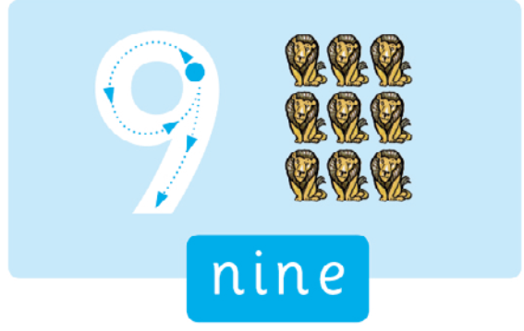


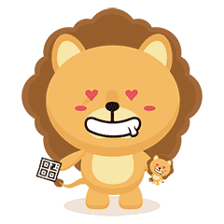

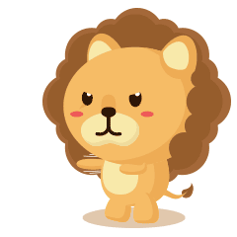
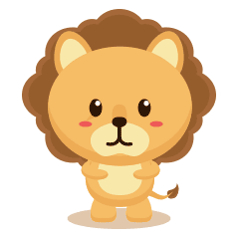

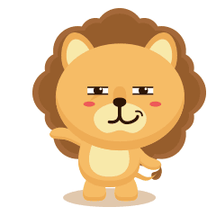

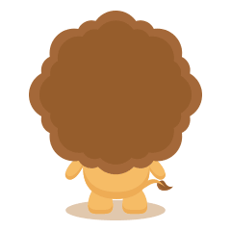

Notes:
- Count and say 9
- Model the word for children to repeat.
- Write number 9 on the board and say NINE.
- Draw dotted outlines of the number 9 on the board and demo how to write them.
- Do the same steps to teach number 10

Slide 6
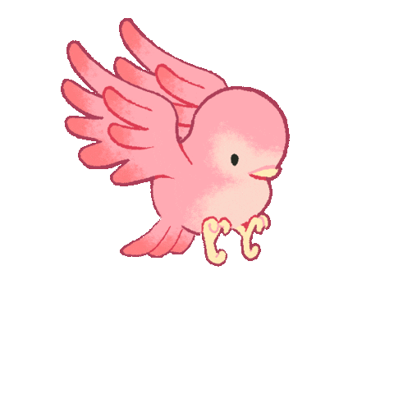
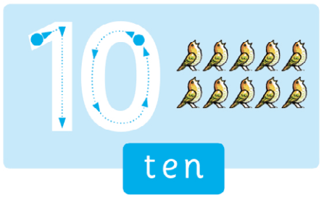
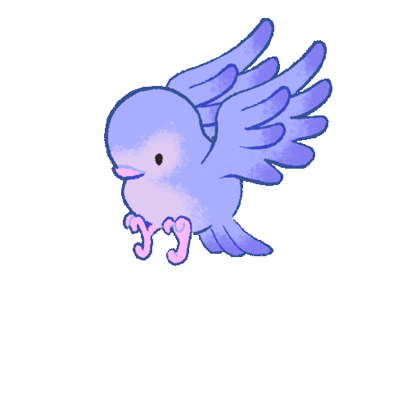

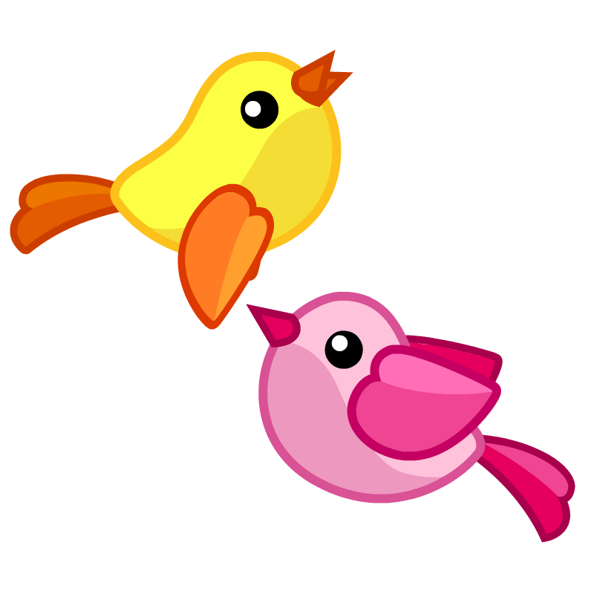

Slide 7

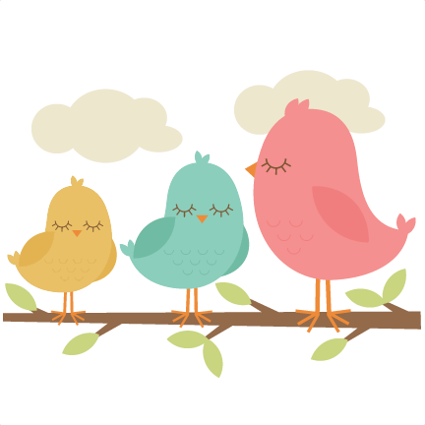

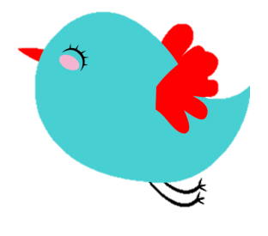
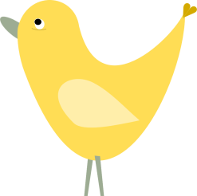
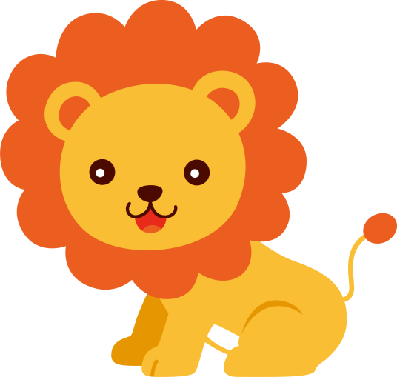


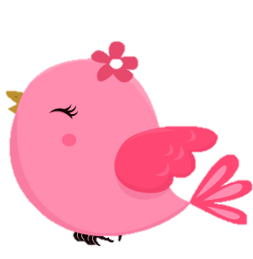




Notes:
Listen, point, and repeat. Write. Track 56
- Play track 56, listen and point
- Play again, ask students to listen and point
- Play again, ask students to listen and repeat
- Model the writing activity
- Ask students to trace and write the numbers
Point and sing: track 57
- Point to the LIONS picture and count.
- Ask students to repeat
- Read the song.
- Ask students to repeat.
- Play all of the song
- Ask students to listen and point to the pictures as they hear the words.
- Play the song again, ask students to sing along.

Slide 8
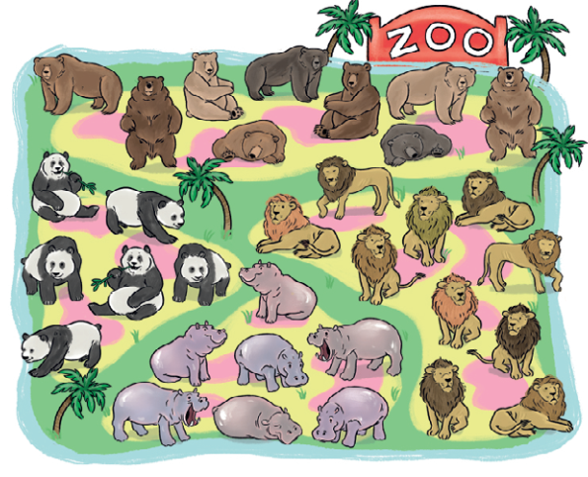

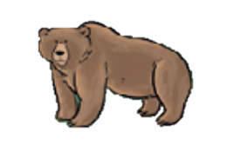

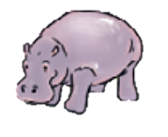
COUNT, CIRCLE and SAY
Notes:
Count, circle and say:
- Look at the picture together and point at the animals as you say the words: bears, hippos.
- Use Phonics card 23 (/l/ lion) to teach lion and Phonics card 31 (/p/ panda) to teach panda.
- Point to the word panda and ask: How many pandas? Circle each panda and encourage the children to count them with you. Elicit nine pandas from the class. Say Nine pandas.
- Ask students to work in pair, look and count the bears, lions, hippos
Below level:
Stick the four flashcards and four phonics cards on the board for activity 3. (Note that there isn’t a flashcard for panda.)
Write the answers next to each animal as a figure, not a word.
At level:
Also use the flashcards and phonics cards for activity 3.
Write the answers next to each animal as a word.
Above level: Follow the instructions for ‘At level’ and then ask children to come to the board and write the number next to the word.

Slide 9
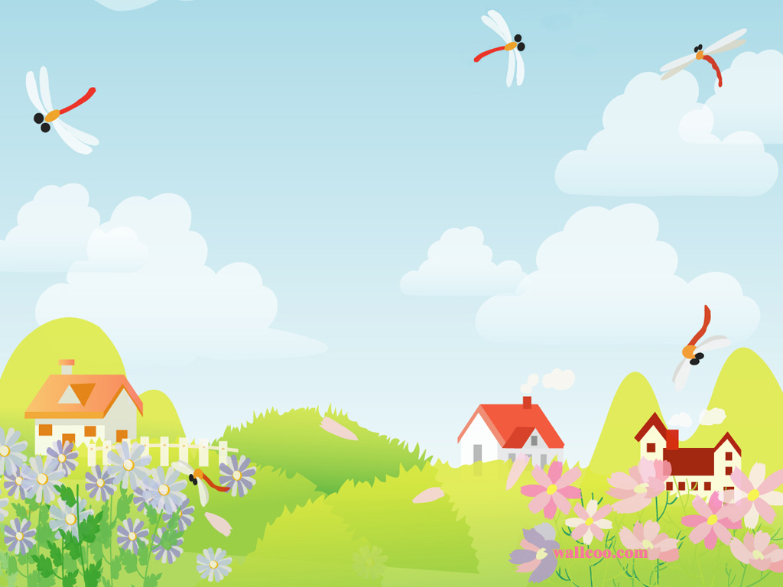
Goodbye !

